Slide 1
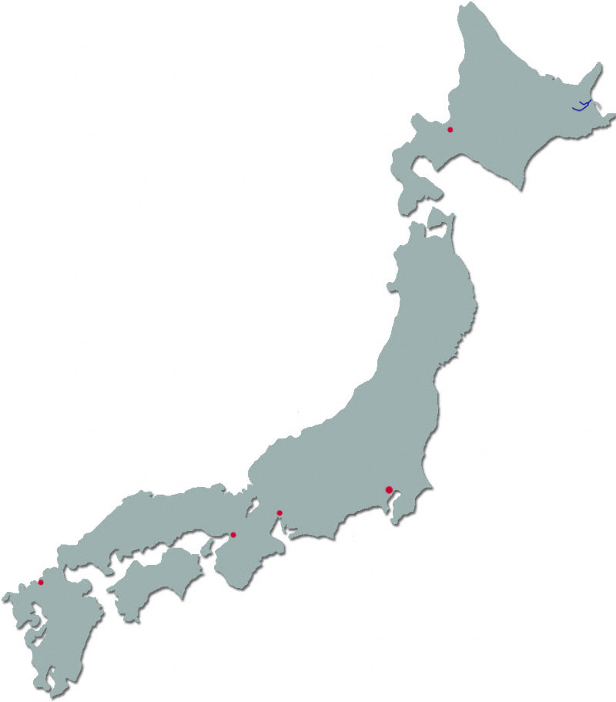
LOGO
Lorem lorem Lorem lorem Lorem lorem Lorem lorem Lorem lorem Lorem lorem Lorem lorem Lorem lorem Lorem lorem Lorem lorem Lorem lorem Lorem lorem Lorem lorem Lorem lorem Lorem lorem Lorem lorem
Hokkaido
Tohoku
Kanto
Chubu
Chugoku
Kinki
Shikoku
Kyushu

Slide 2
LOGO
Map of Regions
Hokkaido
Lorem lorem Lorem lorem Lorem lorem Lorem lorem Lorem lorem Lorem lorem Lorem lorem Lorem lorem Lorem lorem Lorem lorem Lorem lorem Lorem lorem Lorem lorem Lorem lorem Lorem lorem Lorem lorem
Hokkaido
Tohoku
Kanto
Chubu
Chugoku
Kinki
Shikoku
Kyushu
More Articles as you scroll

Slide 3
LOGO
Name of Region
Map of Region
Hokkaido
Article 1
Tohoku
Article 2
Kanto
Chubu
Chugoku
Kinki
Shikoku
Kyushu
Article 3, more as you scroll

